Slide 1
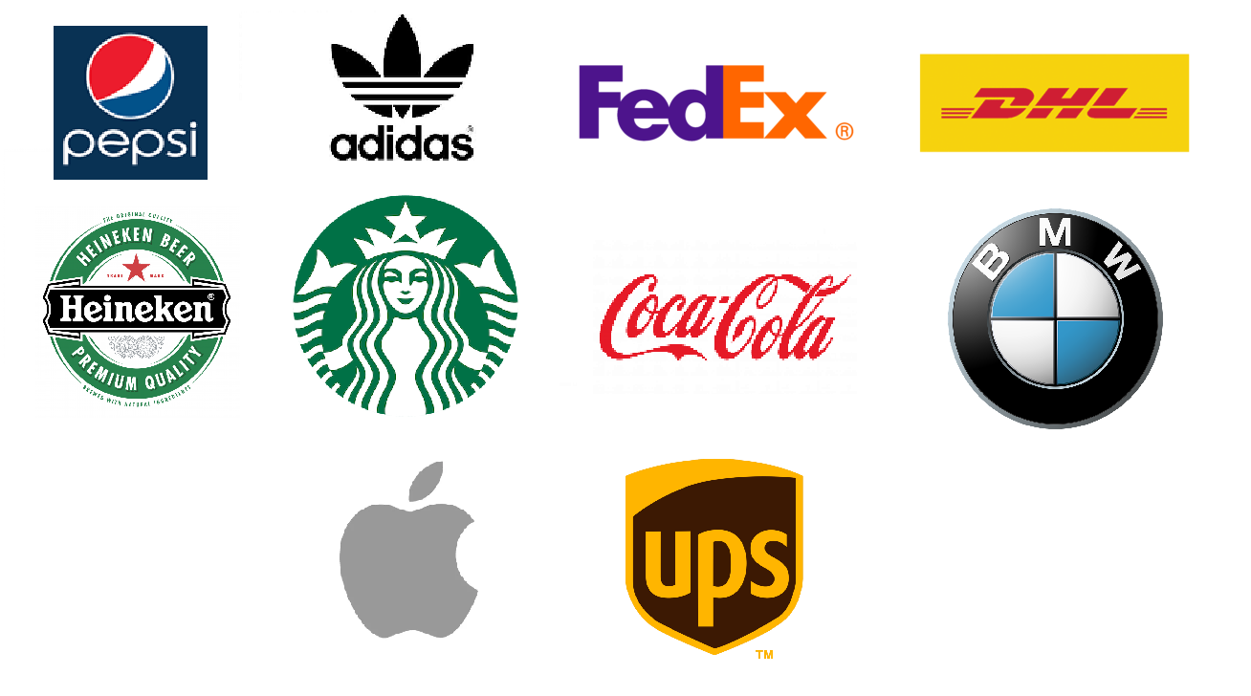
MIDS 281 Final Project - Fall 2022
Eric Liu, John Calzaretta, Luis Chion, Viswanathan Thiagarajan
Instructor : Allen Y. Yang, PhD
Logo Detection
Disclaimer: All trademarks, logos and brand names are the property of their respective owners

Slide 2
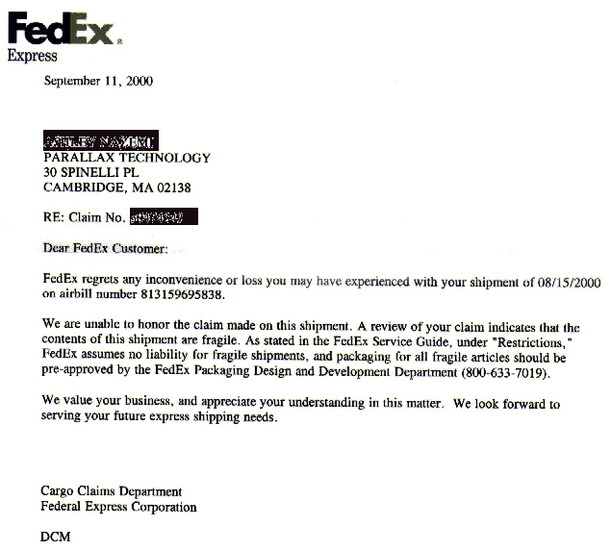

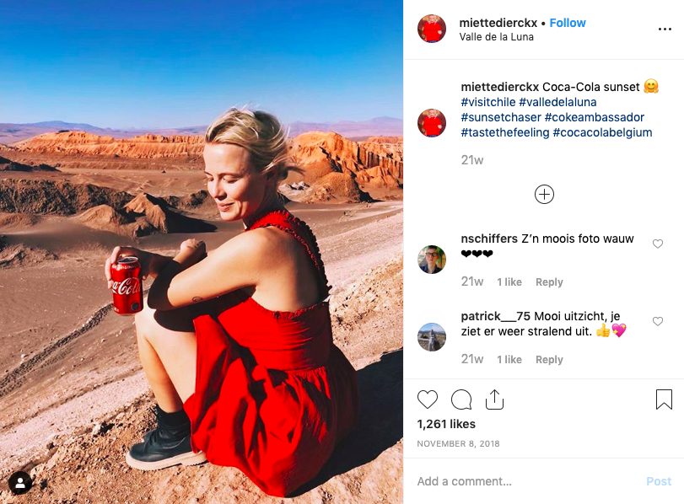
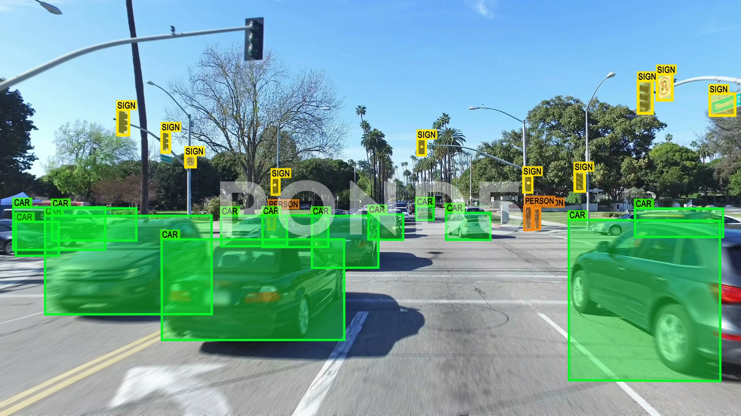
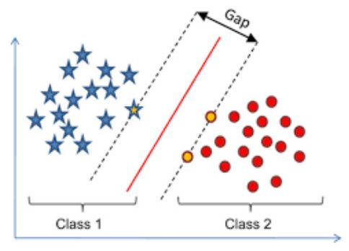
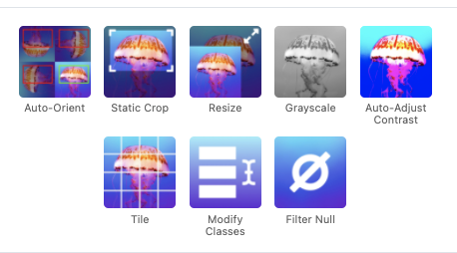
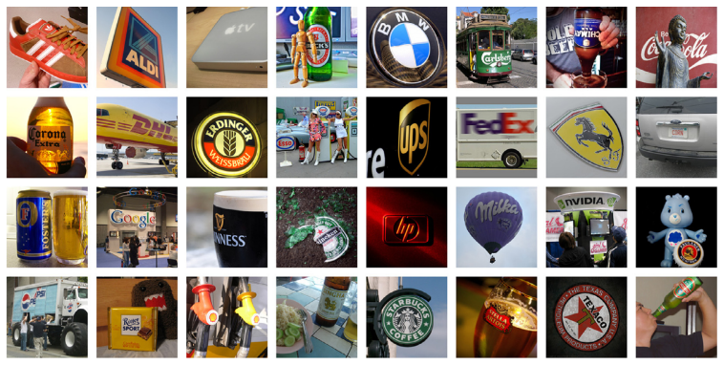
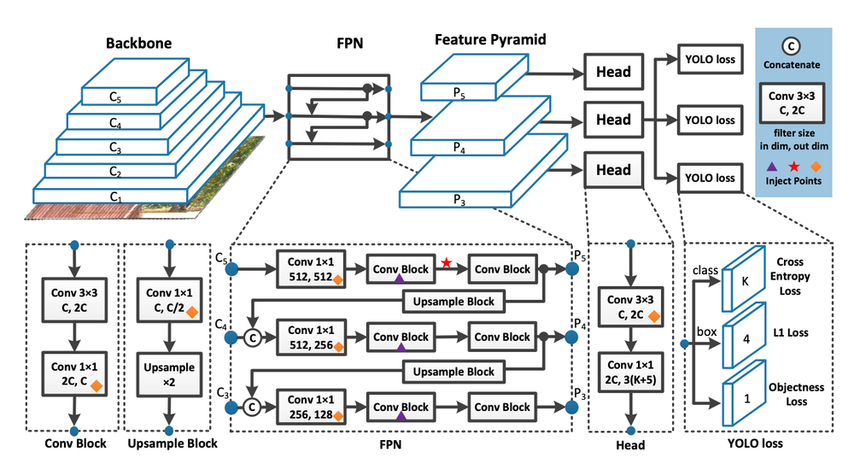
Overview:
Applications:
Copyright and Trademark
Compliance
Brand Statistics
Intelligent Traffic
Control
Doc Categorization
Tasks:
3 SVMs
YOLOv7
Dataset
Pre-processing
Disclaimer: All trademarks, logos and brand names are the property of their respective owners

Slide 3
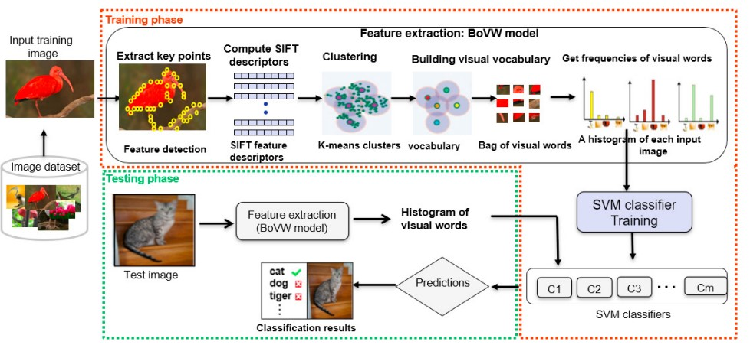
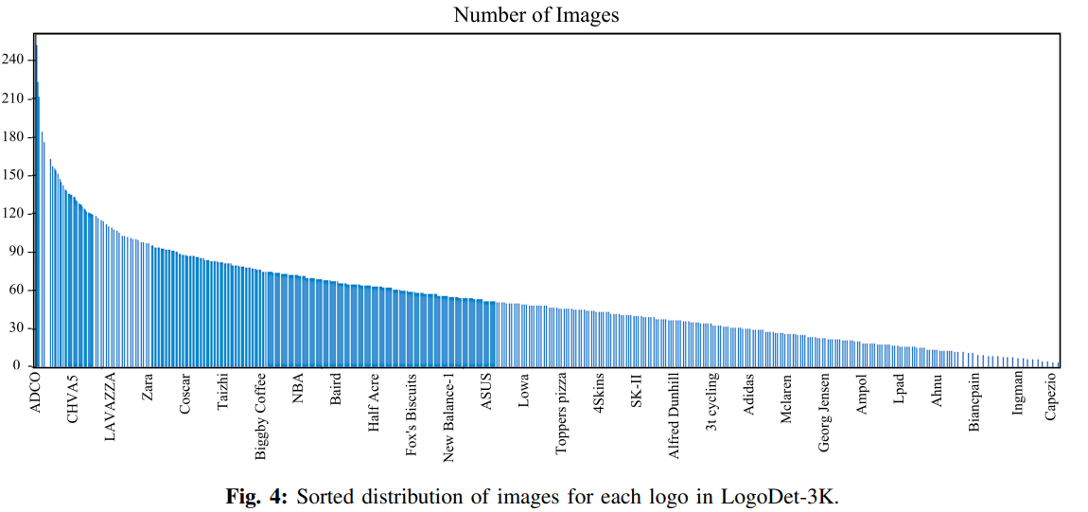
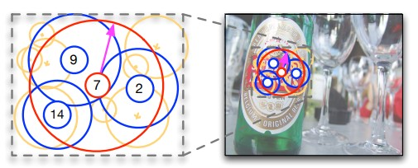
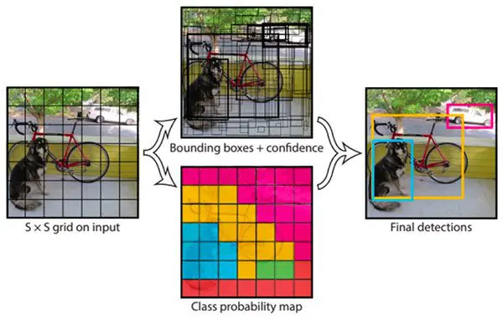
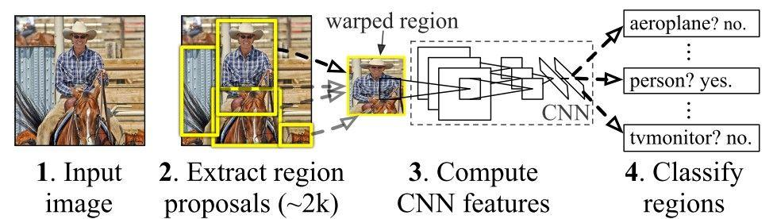
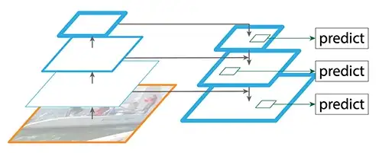
Related Work:
Pre-2015 work:
Dataset:
Sorted distribution of images (LogoDet-3K)
Spatial Grouping
SIFT Bag of Visual Words
Deep Learning:
R-CNNs
Single Shot Detectors (SSD) & Feature Pyramid Network (FPN)
YOLO
Disclaimer: All trademarks, logos and brand names are the property of their respective owners

Slide 4
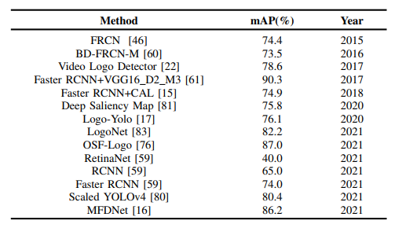
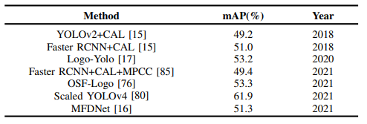
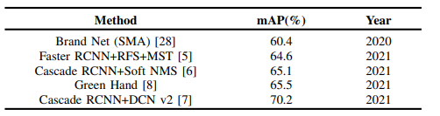
Related Work (cont’d):
Small dataset performance
(FlickrLogos-32 - 32 classes / 2.2K images)
Medium dataset performance
(QMUL-OpenLogo - 352 classes / 27K images)
Large dataset performance
(Open Brands - 1,216 classes / 1.4M images)

Slide 5
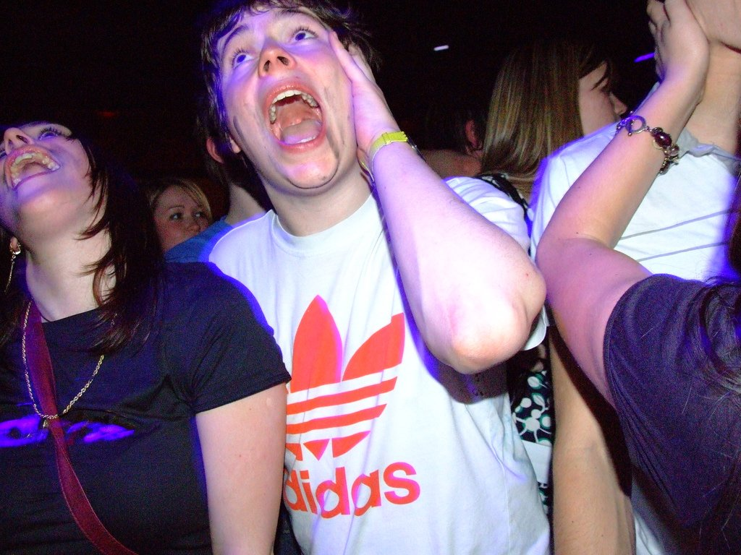
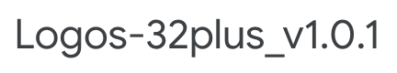
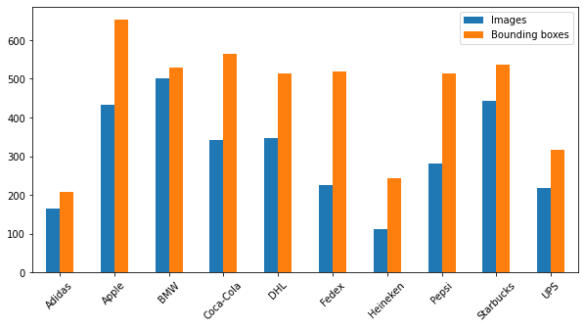
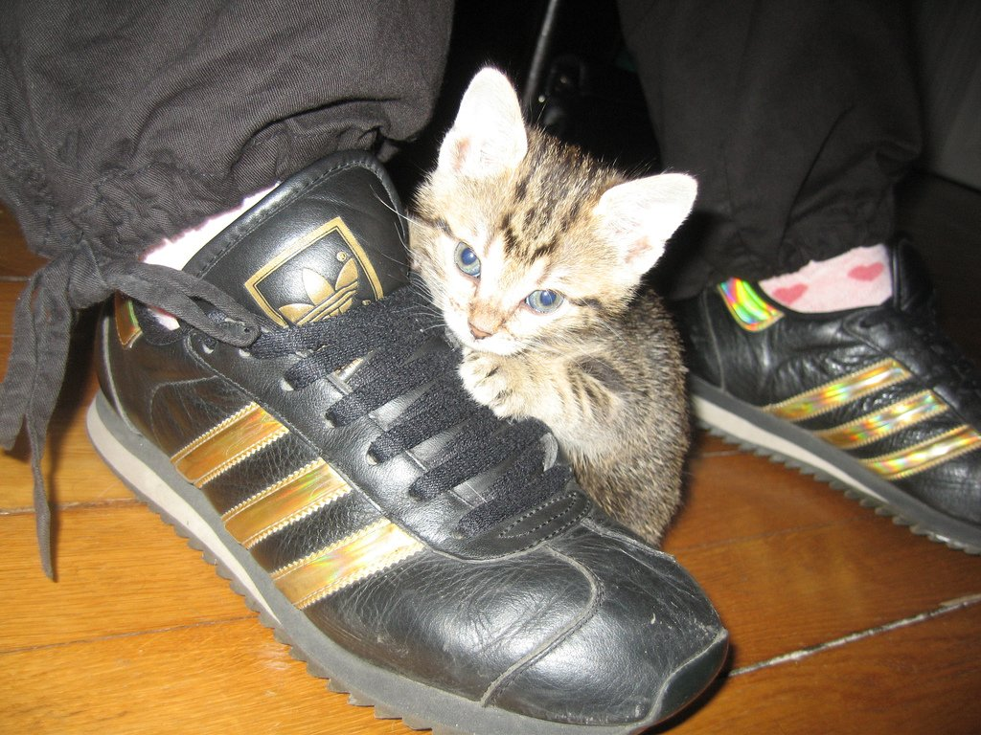
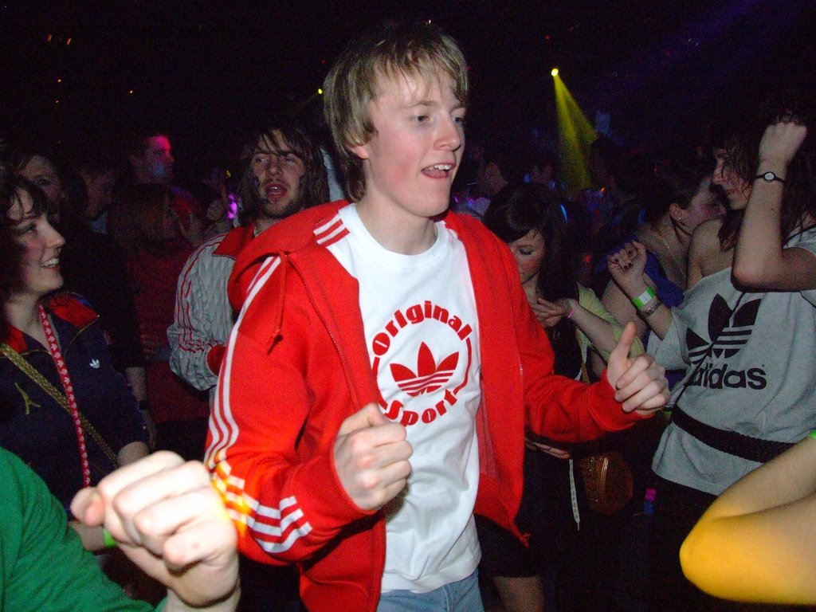
Dataset Description
Disclaimer: All trademarks, logos and brand names are the property of their respective owners

Slide 6
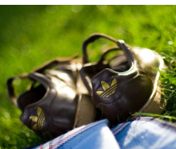
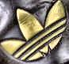
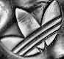
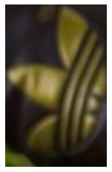
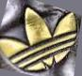
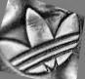
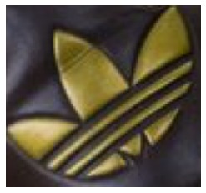
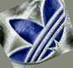
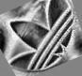
Methods - Image Preprocessing
Data
Augmentation
Grayscale
Contrast Normalization
Extract
bounding boxes
CLAHE
clipLimit = 40.0
tileGridSize = (4,4)
1.5k images/class
15k total images
Disclaimer: All trademarks, logos and brand names are the property of their respective owners

Slide 7
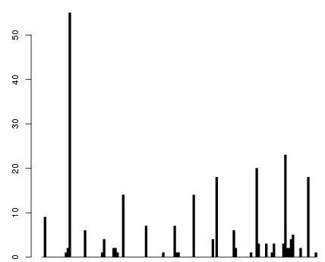
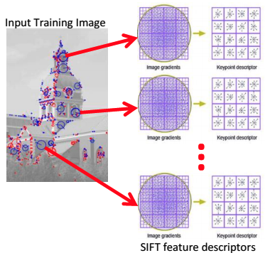
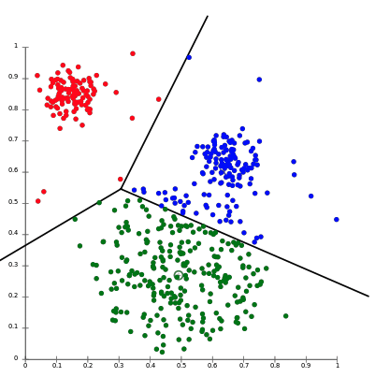
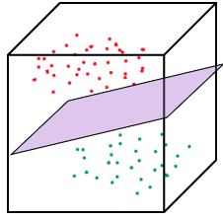
Methods - Bag of Visual Words - SIFT
Scale-invariant feature transform (SIFT)
Works well on images with different colors, scales, illumination and rotations
Locates features in an image, known as "keypoints"
Get frequency of visual words in the image and build a SIFT histogram for each image
Cluster all keypoints from the training set using K-means
# of clusters is a hyper parameter and form the bag of visual words
Parameters used
SIFT Create | 1 Layer, 128 dimensions
K-means | 1500 bins, 3 initializations
SVM One vs Rest | L2 regularization, Balanced class weights
Create SIFT histogram and Predict test data using the trained model
Train a SVM model on the SIFT histograms
Source: https://heraqi.blogspot.com/2017/03/BoW.html

Slide 8


Methods - General Feature Extraction (GFE)
Shape, Color, and Texture features were also extracted from images to see if additional signal can be provided outside of BoW SIFT
Shape Features
Intuition: Some logos can be identified through shape alone
Challenge: Logos may have different versions or be partially obscured
Method: Calculate the Hu moments for each image (invariant to translation, scale, and rotation, and reflection)
Color Features
Intuition: Many brands use consistent color schemes for logos
Challenge: Some brands change color schemes for logos on different products
Method: For each color model (RGB, HSV, YCrCB), get color histogram, then extract the first, second and third color moments from the histogram (mean, variance, skewness respectively)
Texture Features
Intuition: Different brands have products of different textures, potential differentiator (Adidas vs. FedEx)
Challenge: A single brand may have logos of different textures (Adidas shoe vs. Adidas advertisement)
Method: Extract various features from a gray level co-occurrence matrix (Energy, Inertia, Correlation, Entropy)
Disclaimer: All trademarks, logos and brand names are the property of their respective owners

Slide 9
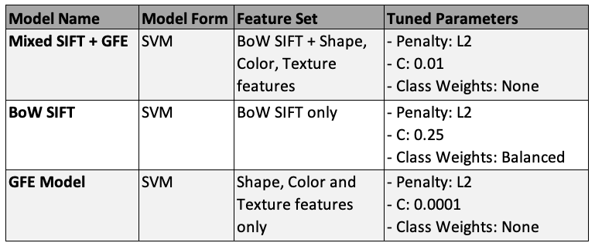
Modeling on Non-Learned Features
Feature Sets
BoW SIFT (alone)
GFE (alone): Shape, Color, Texture
BoW SIFT + GFE Features
Model Forms
Explored: Support Vector Machine (SVM), Multinomial LogReg, K-NN
SVM was top performing model for each feature set

Slide 10
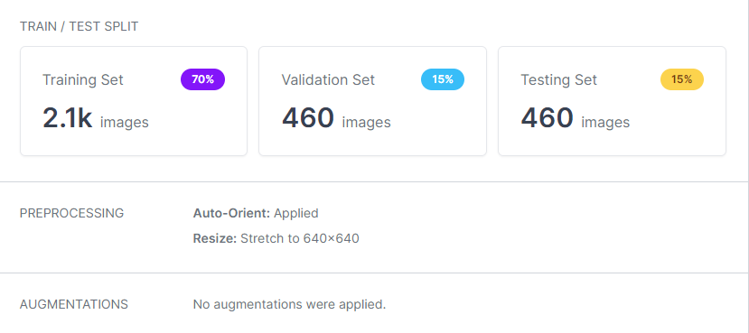
YOLO v7
Parameters:
Batch size : 16
Epochs : 300
Confidence Threshold : 50%
IOU Threshold : 50%
Loaded images into Roboflow:
Model Summary:
Layers : 415
Parameters: 37,245,102
Gradients: 37,245,102
GFLOPS: 105.3

Slide 11
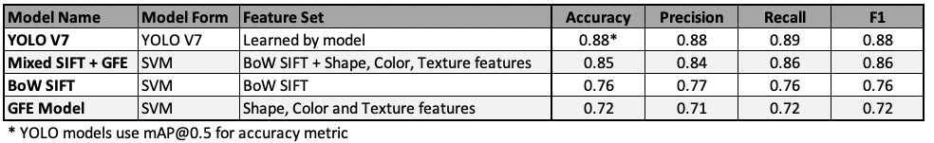
Results Summary
Overall Results
YOLO model is top performer, as expected
Mixed BoW SIFT + GFE model is competitive with YOLO
Mixed BoW SIFT + GFE model outperforms standalone BoW SIFT model
Discussion
YOLO able to learn abstract features specific to the logo domain
BoW SIFT model underfits data. Currently, adding complexity with additional features improves signal

Slide 12
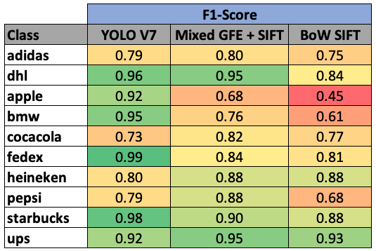
Class-Level Results
Easier Classes (Across Models)
UPS, DHL, Starbucks
Each are relatively distinct and consistent across products (low inter-brand diversity)
Challenging Classes (Across Models)
Adidas, Coca Cola
Likely because these brands have different logos and colors across products and are not usually flat surface
YOLO vs. Mixed GFE + SIFT
YOLO wins at: Apple, BMW
Mixed wins at: Coca Cola, Heineken, Pepsi
YOLO better with smaller logos on flat surfaces with low contrast, struggles with drink brands on curved surfaces
Mixed GFE + SIFT vs. BoW SIFT
Mixed model provides great lift on classes BoW SIFT struggles with most. Similar on other classes

Slide 13

Challenges & Next Steps
Computing capacity
Number of classes in Logos 32 plus dataset (32 vs 10 selected)
Number of visual words in the bag (More vs 1500)
SIFT descriptors - 1 layer (128 dimensions) vs 2 layer (160 dimensions)
Contrast Limited AHE (smaller vs larger kernel)
No keypoint descriptors on homogeneous logo images
Same brand logos with different color schemes, mirror images & textures
Build a classification model that includes all 32 classes
Perform Contrast Limited AHE with a larger kernel
Perform data augmentation for the training similar to the Bianco et al. paper[1]
Use 2 layers in SIFT with 160 dimension keypoint descriptors
Increase complexity of the Mixed model by introducing additional manual features
NEXT
[1] https://doi.org/10.1016/j.neucom.2017.03.051

Slide 14
Appendix

Slide 15
State of the Art Comparison
Apples-to-Oranges Comparison
Our models are developed on a subset of 10 classes in the Logos32+ dataset (compute constraints) and do not include a background class. Direct comparisons are invalid.
Yet, we hope to understand where our models sit in relation to SOTA approaches.
Method | Train Data | Precision | Recall | F1 | Accuracy
BoW SIFT (Romberg et al.) | FL32 | 0.99 | 0.78 | 0.88 | 0.94
BoW SIFT (W281) | L32+ Subset | 0.77 | 0.76 | 0.76 | 0.76
Mixed GFE + BoW SIFT (W281) | L32+ Subset | 0.84 | 0.86 | 0.86 | 0.85
CNN (Bianco et al.) | FL32 | 0.88 | 0.89 | 0.88 | 0.88
YOLO V7 (W281) | L32+ Subset | 0.77 | 0.76 | 0.76 | 0.76
Discussion
The BoW SIFT and CNN models fit on FlickrLogos-32 dataset in Romberg et al., Bianco et al. (respectively) outperform our BoW SIFT and YOLO models.
Though a direct comparison is invalid, we hypothesize that differences can be primarily attributed to our model working with a subset of classes, not including a background class, and not utilizing data augmentation.

Slide 16
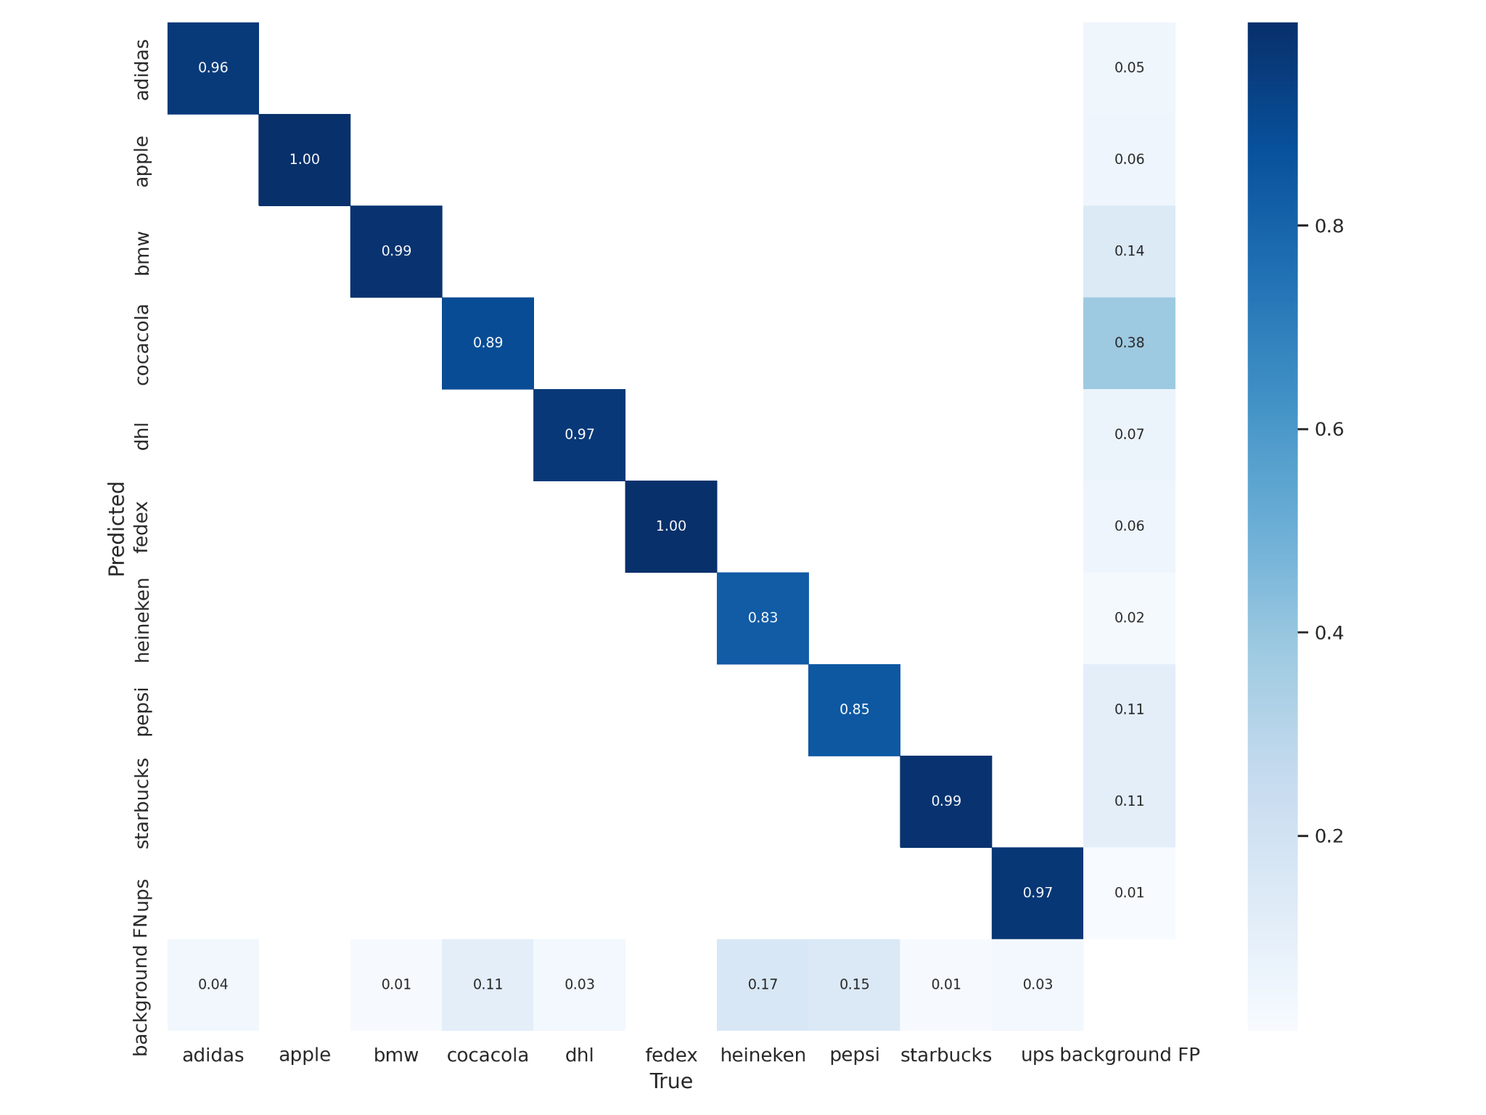
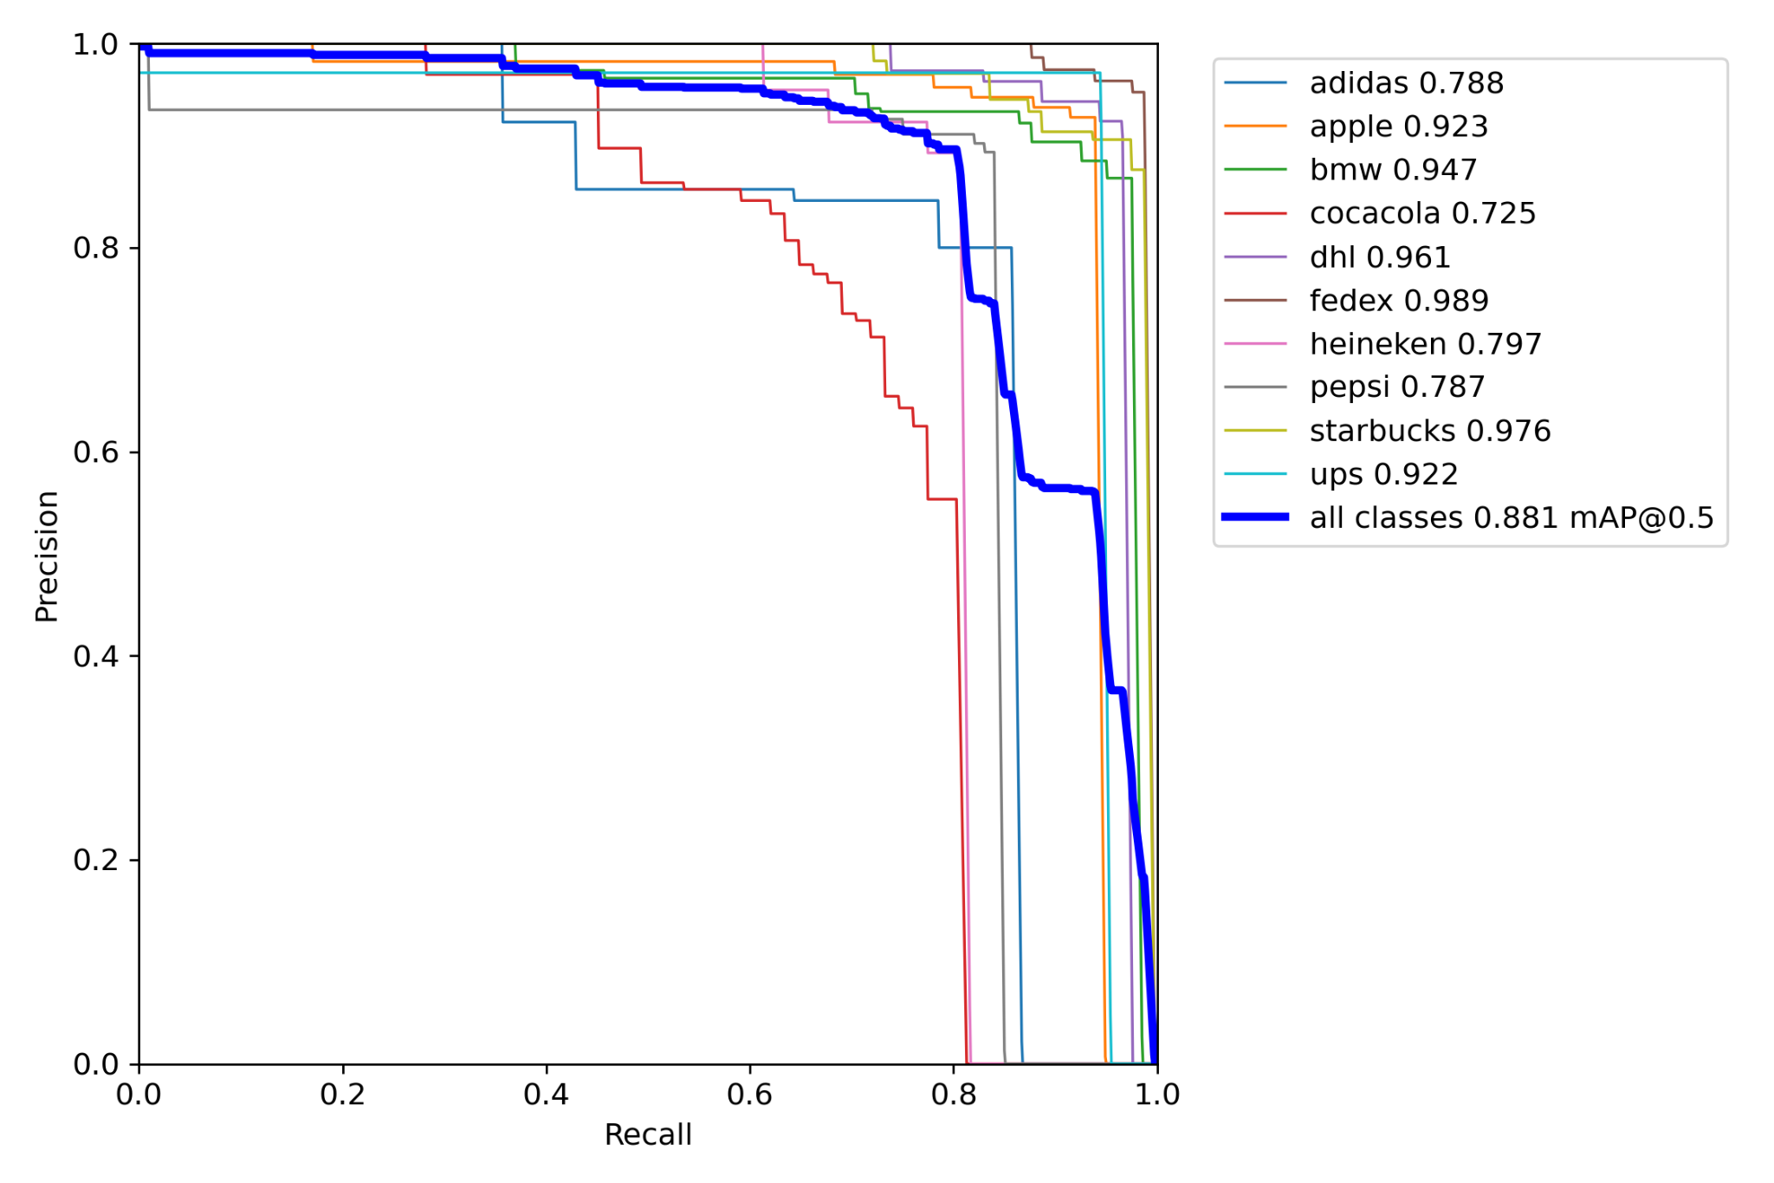
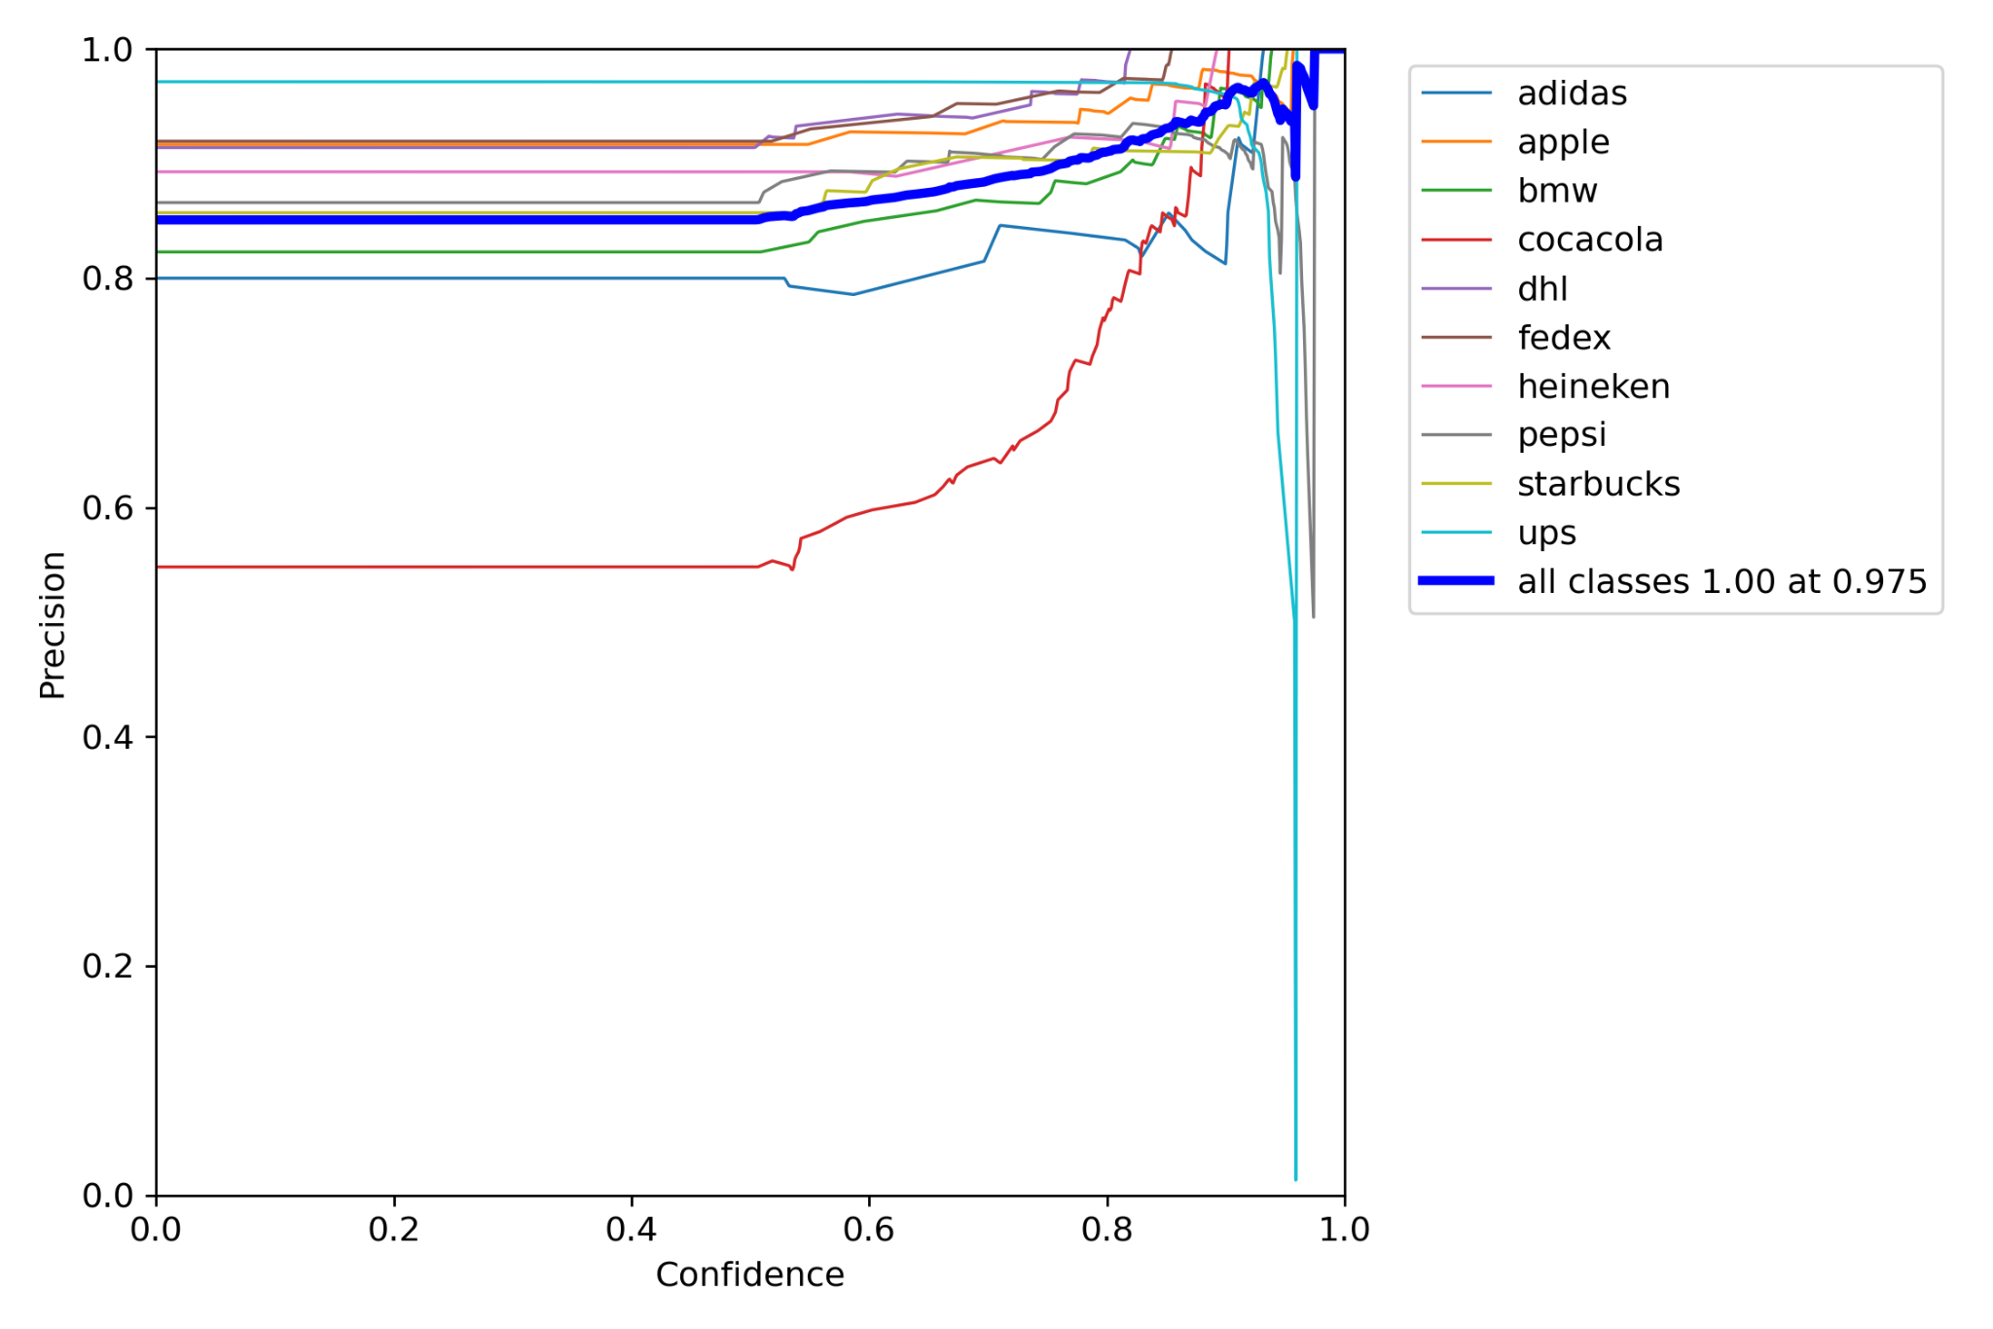
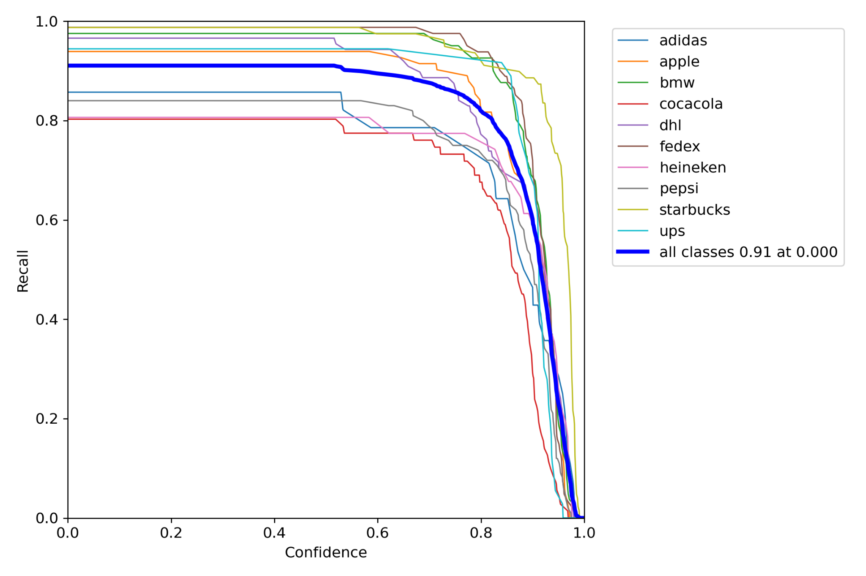
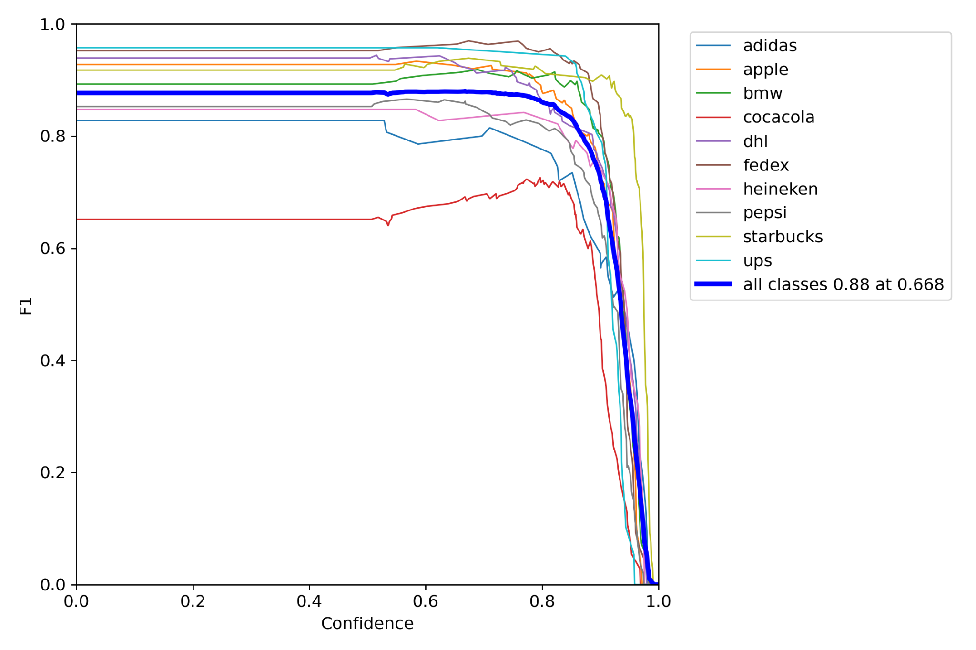
YOLO Additional Output

Slide 17
Thank you

